Slide 1
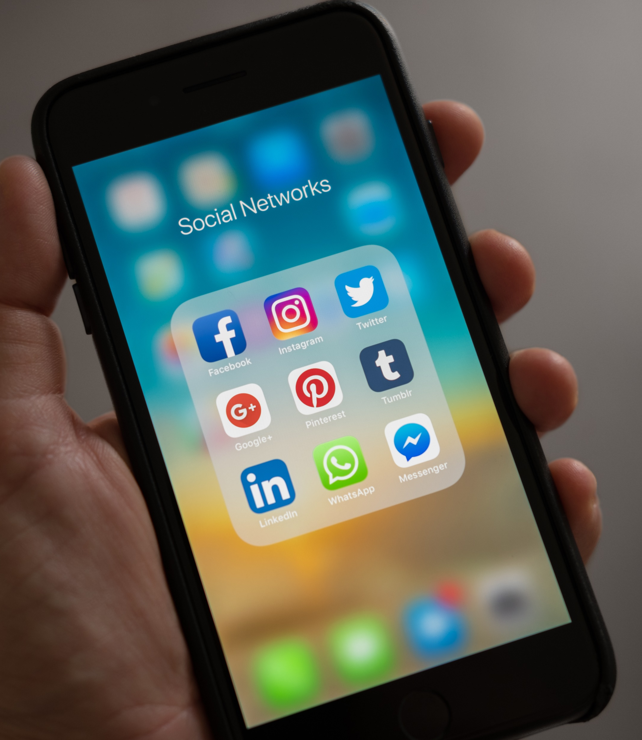
The 10 Apps That App Trader should purchase

Slide 2
Criteria Used
Both App store and Play Store
Content Rating No Matured Apps
Total amount of Reviews
Choose Apps With in App Purchases
Reviews 3.5 And Higher

Slide 3
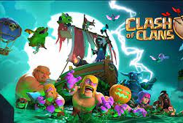
Clash of Clans
Price: Free
Rating 4.5
Investment 25,000$ + 1000$/month
Profits:5000$ Per Month – 1000$ per Month, Yearly income after Advertisement 48,000$ per year
After 9 years it would be 432,000$ in Profit

Slide 4

PAC-MAN
Price: Free
Rating 3.6
Invest 25,000$ +1000/month

